Slide 1

Diversity in Tech
Jerin Black

Slide 2
Extraction
2019-2015
Excel
2014-2012
Excel and HTML
2011
Text and HTML

Slide 3
Cleaning
2019-2015
Filtered in Excel to find all tech related careers.
Saved files as CSVs, UTF-8 to read into Pandas.
Did .loc to locate those careers in Pandas to rid of the other occupations.
Merged files based on occupation.
2014-2012
Saved files as CSVs, UTF-8 to read into Pandas.
Did web scraping to import the BLS table – all of them had triple headers.
Did .loc to locate those careers in Pandas to rid of the other occupations.
2011
.txt file caused a lot of issues when cleaning it up in Word.
Finally was able to figure it out and get create an Excel table.
Merged information based on occupation.
Merged files based on occupation.

Slide 4
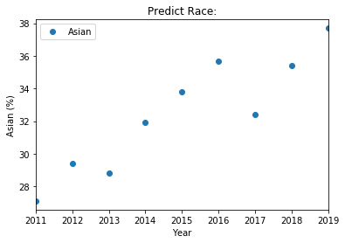
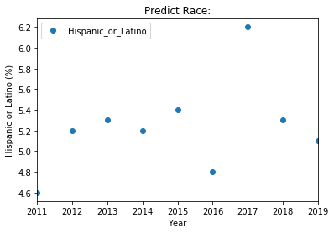
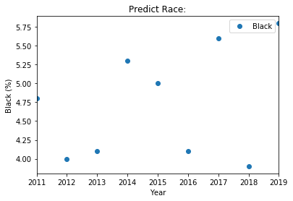
Challenges aka Machine Learning

Slide 5
Data Sources
https://www.informationisbeautiful.net/visualizations/diversity-in-tech/
https://www.bls.gov/cps/definitions.htm
https://www.bls.gov/opub/ted/2019/black-women-made-up-53-percent-of-the-black-labor-force-in-2018.htm
https://www.bls.gov/cps/demographics.htm#women
https://www.bls.gov/cps/race_ethnicity_2008_5.htm
https://www.bls.gov/opub/reports/race-and-ethnicity/2018/home.htm#:~:text=The%20employment%E2%80%93population%20ratio%20was,%2C%205%2C%20and%205A.)
https://theundercoverrecruiter.com/top-10-us-tech-diversity/
https://www.bls.gov/opub/reports/race-and-ethnicity/2018/home.htm
https://www.bls.gov/cps/tables.htm

